Slide 1


THE MOST UNUSUAL BUSINESS MODELS THAT SUCCEEDED
MADE BY
-SHOHINI ROY
-VIDHI SHARMA
-MAYUR GUNJAL
-ASHWIN DHUMAL

Slide 2
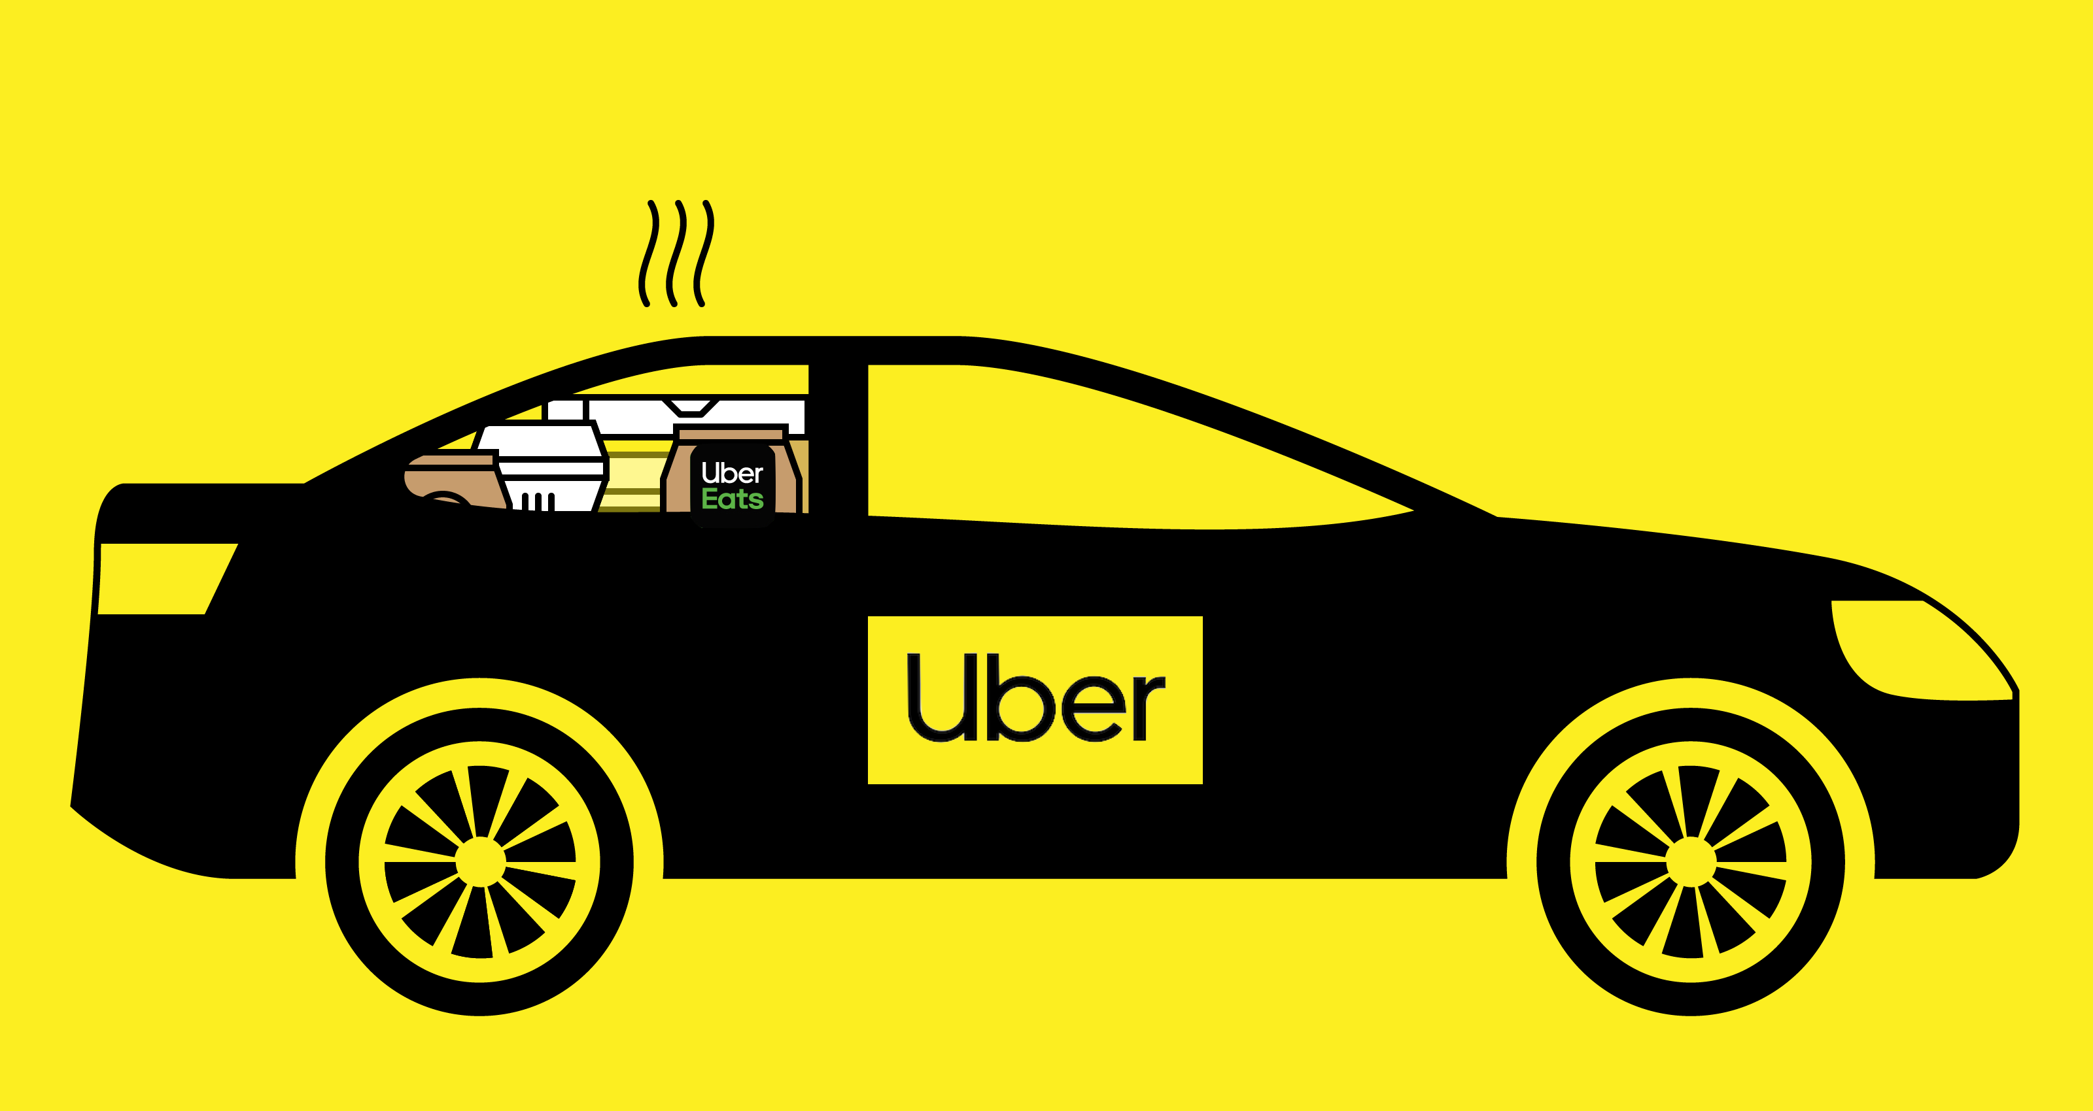
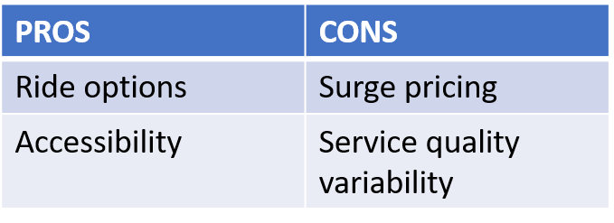
ONLINE DOORSTEP TRANSPORT SERVICE- UBER
MEANING
HELPS
PROS AND CONS:

Slide 3
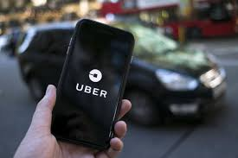
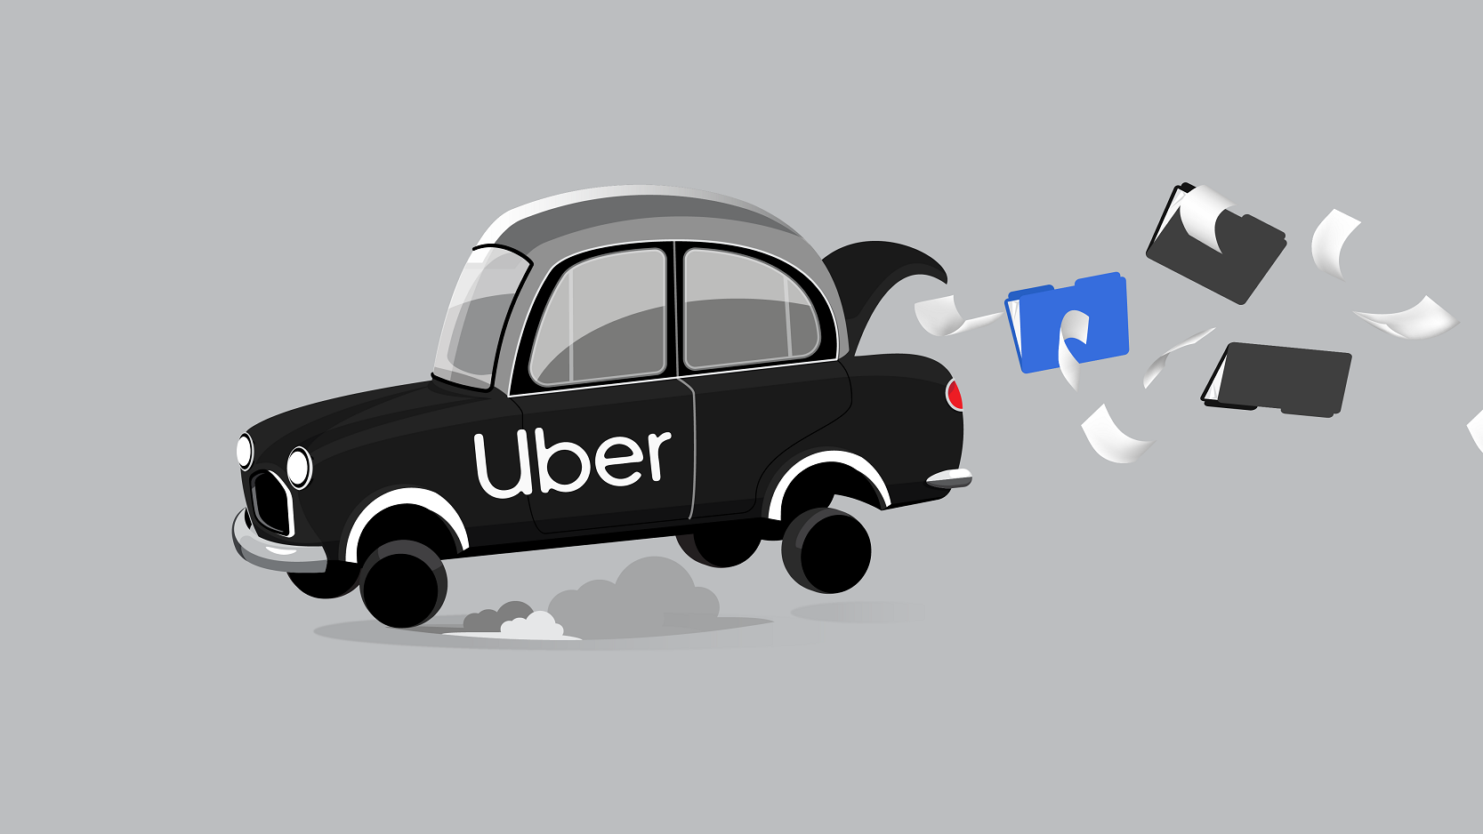
HOW UBER SUCCEEDED:- Technology Integration Adaptability and Innovation Aggressive Expansion Strategy.
WHAT CHALLENGES DID UBER FACE:- Competition Safety Concerns Financial Sustainability Public Relations and Reputation

Slide 4

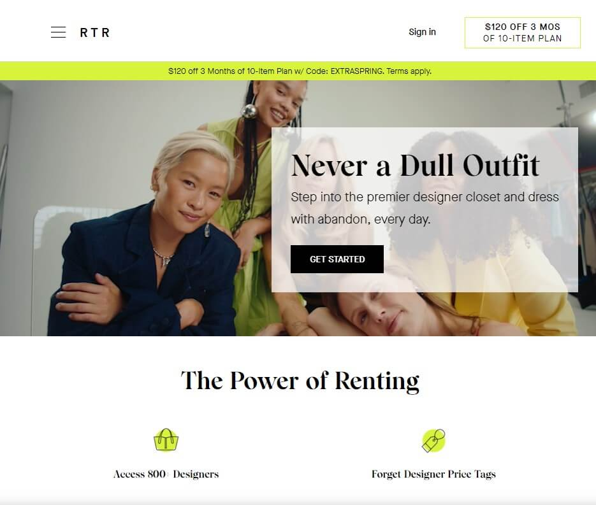
“RENT THE RUNWAY”
A FASHION REVOLUTION

Slide 5


WHAT WAS THE PROBLEM ?
BUSINESS MODELS :-
1
Rental Subscription
2
One-Time Rental
3
Resale

Slide 6

IMPACT ON THE FASHION INDUSTRY -
CONSUMER BEHAVIOUR
BUSINESS MARKET INNOVATION
ECONOMIC IMPACT
IMPACT ON THE CONSUMER -
AFFORDABILITY
SUSTAINABILITY
CONVENIENT

Slide 7

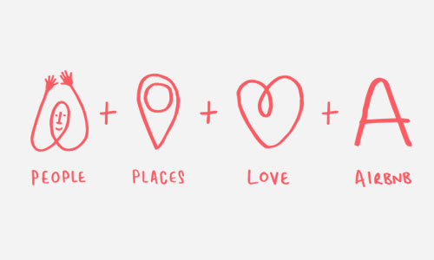

Introduction to Airbnb
History of Airbnb

Slide 8
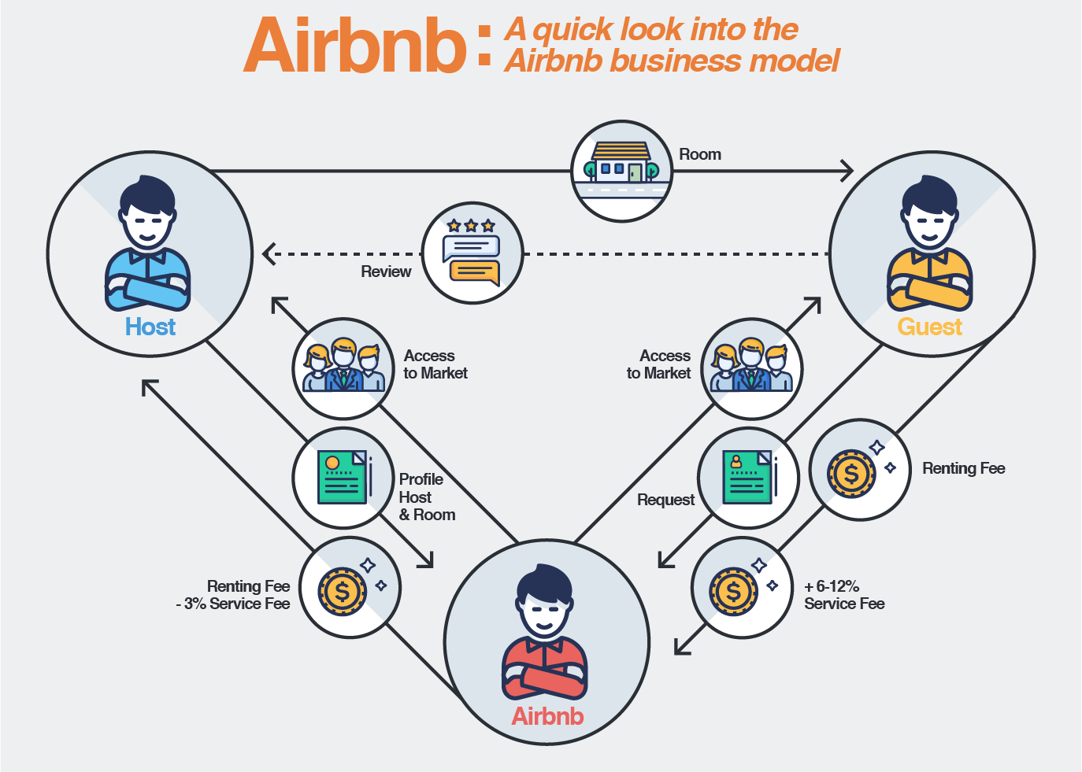
Airbnb Business Model
Growth of Airbnb
Advantages
Disadvantages
Unique Selling Proposition(USP)

Slide 9
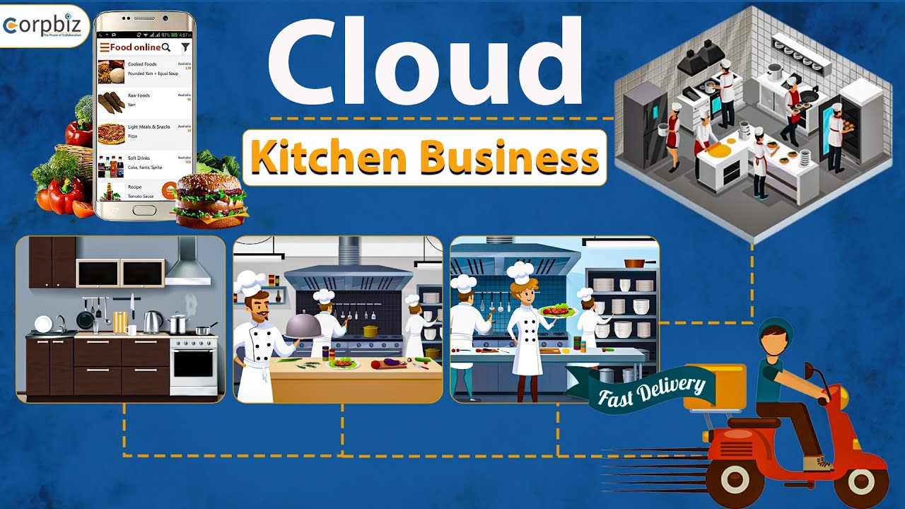
Cloud Kitchen
CONCEPT
IDEA
NEED

Slide 10

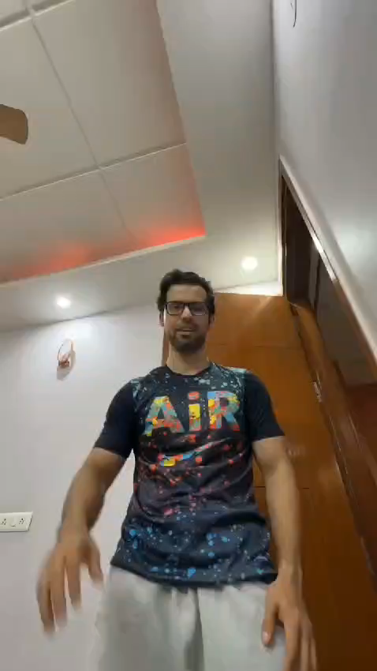
Challenges Faced
Impact On The Market
Complementing Other Businesses

Slide 11
THANK YOU

